Slide 1
The effect of food
Maria F. Martinez

Slide 2
We are going to learn about
The relationship between the C02 Emissions and the increase in temperature
Analyze the Contribution of Different Agricultural Activities to CO2 Emissions
Be part of the change and donate on the organizations available by your country

Slide 3
Key words
A gigatonne is 1,000,000,000 tonnes, and is often used when discussing human carbon dioxide emissionns.
Global carbon dioxide (CO₂) emissions from energy combustion and industrial processes1 grew 0.9% or 321 Mt in 2022 to a new all-time high of 36.8 Gt.

Slide 4
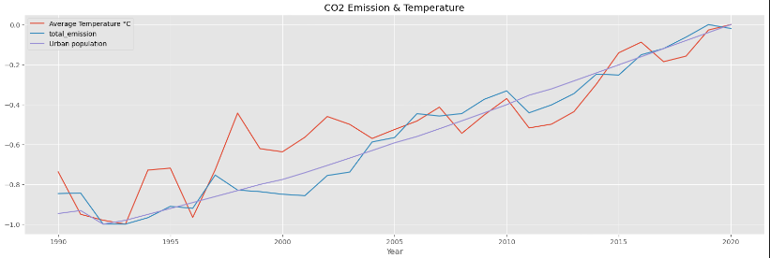
The relation of temp, emisions and population

Slide 5
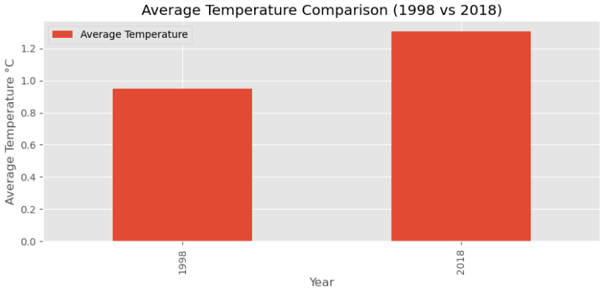
Over 20 years

Slide 6
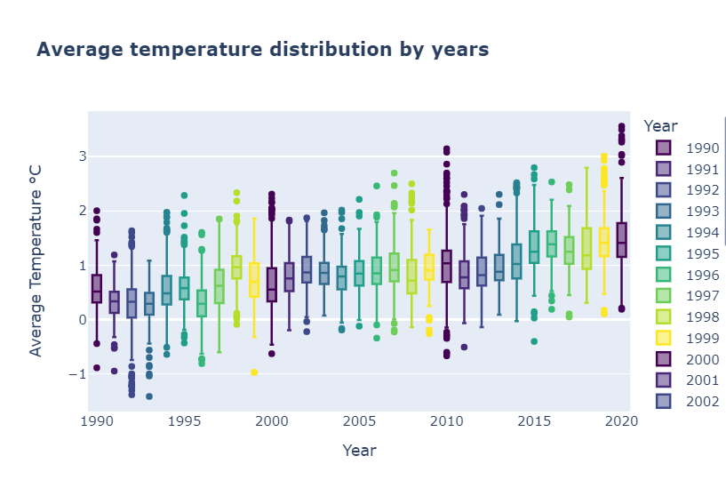
Average temperature distribution by years

Slide 7
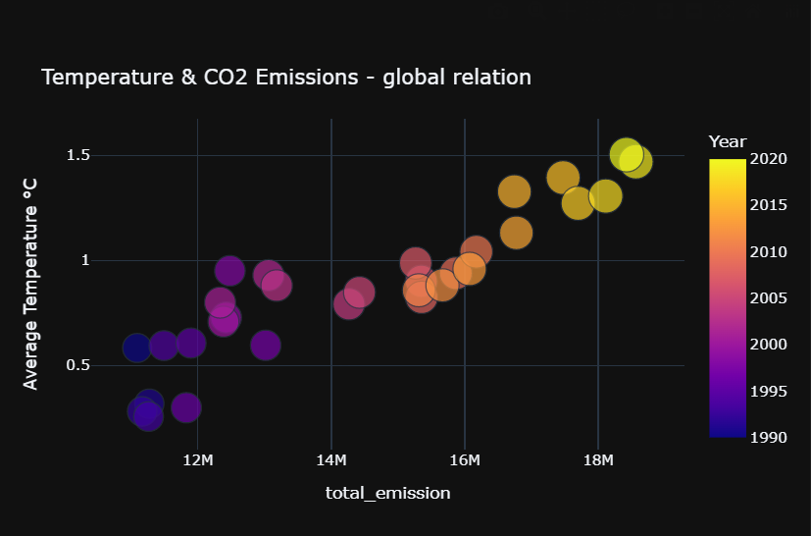
Comparison between continents with the highest number of population

Slide 8
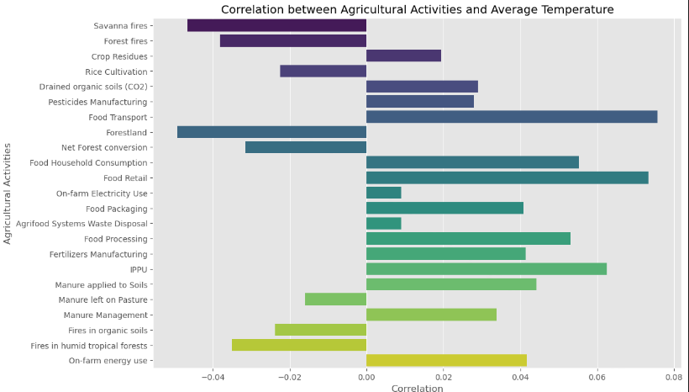
Correlation between the activities and the temperature
TAKUMA HAYASHI
MIRJAM NILSSON
FLORA BERGGREN​
President
Chief Executive Officer
Chief Operations Officer
VP Marketing

Slide 9
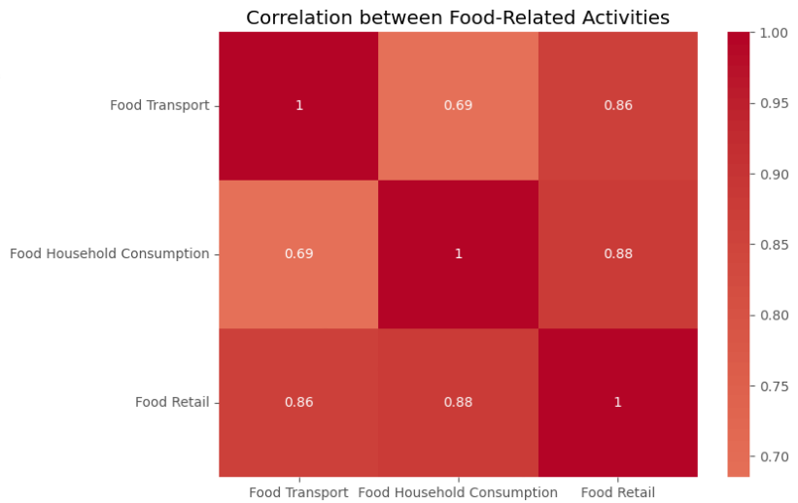
THE correlation between 'Food transport', 'Food household Consumption' and 'Food Retail'
The value of 'Food Transport' increases, the values of the other variables also increase proportionally, following a straight-line pattern.

Slide 10
The activity with most c02 emissions
The activity with the most CO2 emissions is 'Rural population' with 124379127014.0 CO2 emissions.

Slide 11


What can we do?
Through the AWS platform, it will give you the option that depending on what country you would like to donate it will take you to the links of the organization to donate

Slide 12
THANK YOU
Maria Fernanda Martinez

